Slide 1
Locks
Dr. Manjiree Vyawahare
Notes:
Book PL/SQL : THE ROGRAMMING LANGUAGE OF ORACLE by Ieven bayross

Slide 2
The technique employed by oracle engine to protect table data when several people are accessing it is called Concurrency Control
Oracle uses a method called Locking to implementt concurrency control when multiple users accesse a table n to manipulate its data at the same time
Locks are mechanism used to ensure data integrity while allowing maximn councurrent access to data
oracle loking is ffully automatic and requiresno users intervention
Oracle automaticaaly locks table data while executing SQL statements
This type of loking is called as Implecit Locking
This is an defult locking strategies

Slide 3
Types of Locks
Types of locks are depends on the operations being performed on the table data
Basically it is divided it to two categories
1 Read Operation: SELECT Statement
2 Write Operation: INSERT,DELETE, UPDATE
Read operation is safe operation as it doesn’t make any changes in table data
Read operation performed without any danger
That’s why Oracle engine perform a share Lock on table when data is being viewed

Slide 4
While performaing write operatioin …causes a change in table
Write operation can adversly affected table data integrity
Write operation cause ‘loss of data consistency’
Hense oracle engine places ‘Exclusive’ Lock on a table or specific section of the tables resoures whne he data is being written to table

Slide 5
Rules of Locking
Data being changed cannot be READ
Write wait for other writers , if they attempts to update the same rows at the same time

Slide 6
Types of Locks
Shared Locks
Performed on Read operation
Multiple shared Locks can be simultaneously set on a resourses
Exclusive Locks
Write operation
Only one exclusive locks re placed on resourses at a time
That is the First user who acquires a exclusive lock will continue to have the sole 0wnwership of the resourses and no othher user can aquire an exclsive lock

Slide 7
Levels of Locks
Basically tabel is a havving rows and columns
Rows are called as reocrds
Many user or single user can e woring on a single records i.e each on a differen filed of same records in the same table ( Oracle does not provide field level locking)a
It provides three level of locking
Row Level
Page Level
Table Level
Level of locking are desided on the basis of WHERE Clause

Slide 8
If where clause evaluates to only one Row in a table : ROW LEVEL Locking
If where clause evaluates set of data : PAGE LEVEL Locking
If there s no where clsuse : ( Query access entire table) : TABLE LevelLocking

Slide 9
Example of implicit locking
Suppose monika and gargi are applying for the MCA Admission.
Monika has send admission form 1st and then gargi has send it 2nd ly
By default oracle updtes the admission db by doing monikas admission….
In between oracle implicitly locks the records sothat no other student can manipulate the same till the lock is released.
This lock will released when monikas admission has been completed and committ or rollback is fired

Slide 10
In between gargi tries to view the same record , that time oracle engine displays old set of data as the transaction of previous transaction has not been completed by monika
This leads to WRONG information has been displayed to Gargi ( that still some seats are available in MCA)
That’s why first client (monika) must Explicitly lock the record such that no other user can access the record the for read (view ) purpose till the completion of first transaction.

Slide 11
Explicit Locking
Who can explicitly Lock?
User can lock table s they own or any tables on which that have been granted table privileges ( such as select, insert, update ,delete)
Select…For …update statement
It is used for acquiring exclusive row level lock in anticipation of performing update in records
This clause is used to signal the oracle engine that data is currently being used needs to be updated.
It is often followed by one or more update statement with a where clause

Slide 12
example
Client A: SELECT * FROM SALES_ORDER WHERE order_no=‘O101’ FOR UPDATE;
Locks the record ‘O101’ till commit or rollback y client A
Client B: : SELECT * FROM SALES_ORDER WHERE order_no=‘O101’ FOR UPDATE;
Now client B has to wait…till commit or rollback from client A…FOREVER

Slide 13
To avoid forever waiting ( i.e don’t know the termination of transaction A’s)
To avoid unnecessary waiting time NO WAIT option can be used
NO wait option tells the engine to terminate the current DML statement and come up with the message indicated that resources are busy

Slide 14
Client B: : SELECT * FROM SALES_ORDER WHERE order_no=‘O101’ FOR UPDATE NOWAIT;
As clientt A has already lock this reocrd for update purpose.
Oracle displayes msg on screen
SQL> 00054:resourse busy and acquire with nowait specified

Slide 15
Select for update cannot be used with the
Distinct and group by clause
Set operators and group function

Slide 16
Lock command Syntax
LOCK TABLE tablename[,tablename..]….view
IN { ROW SHARED| ROW EXCLUSIVE|SHARE UPDATE|SHARE|SHARE ROW EXCLUSIVE} [NOWAIT]
Table name : table name , views to be locked [ in case of view lock is placed on undelaying tables]

Slide 17
IN : decides what other locks on the same resource can exist simultaneously
For example ..suppose ther is exclusive lock on a table ..no userrcan update rows in the table, it can have following values
Exclusive: they allow query on the locked resourse but prohibit any other activity
Share: allows query…but prohibit update
Row Exclusive: prohibit locking in share mode same as row share lock…. These Locks are aquired while Update ,Insert, Delete

Slide 18
NOWAIT : indicate thet orale engine should immediately retuurn the userr with the msg,if the resourses are busy
If nowait is omitted then oracle will wait till the completion of ransactin and resourses becomes free …forever

Slide 19
Example EMP table
Emp_code | Emp_name | salary
E101 | POORVI | 60000
E102 | GARGI | 70000
E103 | MONIKA | 50000
E104 | ANIKET | 80000
E105 | AADYA | 90000
Suppose two clients has to perform data manipulation of emp table
Client A has Locked the table in exclusive mode
Client A> LOCK TABLE emp IN Exclusive Mode NOWAIT;
Client A performed insert operation…but does not commit the transaction
Client A> insert Into emp VALUES ( ‘E106’,’ Radhika’,50000);
Client B> SELECT * From emp;
Output will be as above table
Now Client B perform insert operation
Client B> insert Into emp VALUES ( ‘E107’,’ shamika’,80000);
Client B has put on wait state ….till the lock get release by client A..

Slide 20
Inferences
When client A Locks table in exclusive mode …table is available only for Query…..no other DML allowed (IUD commands)
Since client A has inserted but not commited ….not visible to client B
Client B want to insert….system is in indefinite wait period till all locks are released by client A on table

Slide 21
Release of Locks
Locks are released under the following circumstances
Transaction has been completed by “commit”
A Rollback is performed
A rollback to a save point will release locks fter the specified save point
[note: row level locks are not released by rolling back to a savepoint ]

Slide 22
Explicit Locking
***Insert Operation
When two or more than two client are handling same db then
Client A> Insert into command
Client A> Select Statement
Note : client A can view newly added record
Client B> select
Cannot view newly insertd record
As client A has not yet committed it
[ client A can perform update and delete operation on newly inserted record as it is available on client A side buffer, this record is not yet exist in the server side table… because A has not committed it|
Same for the update command…. Updated recor can viewed by A but B can view old values …not updated new values

Slide 23
Client A> select c_no,name,balance from client _master FOR UPDATE;
Client A> UPDATE client_master SET bal=50000 WHERE c_no=‘C105’;
Client B> SELECT c_no,name,bal from client _master FOR UPDATE NOWAIT;
SQL> 0054:resource busy and acquired with nowait specified
No rows selected

Slide 24
inferences
The select for update fired by A acquired an exclusive lock on all the records of client master table
Since A has not committed the recored of clien C105 which was updated .. Hence engine returns msg ..as B has fired select Query with nowait
B can do transactions when A performs commit or rollback
Same senario will be performed for delete and update commands

Slide 26
Lock-Based Protocol
In this type of protocol, any transaction cannot read or write data until it acquires an appropriate lock on it. There are two types of lock:
1. Shared lock:
It is also known as a Read-only lock. In a shared lock, the data item can only read by the transaction.
It can be shared between the transactions because when the transaction holds a lock, then it can't update the data on the data item.
2. Exclusive lock:
In the exclusive lock, the data item can be both reads as well as written by the transaction.
This lock is exclusive, and in this lock, multiple transactions do not modify the same data simultaneously.

Slide 27
There are four types of lock protocols available:
1. Simplistic lock protocol
It is the simplest way of locking the data while transaction. Simplistic lock-based protocols allow all the transactions to get the lock on the data before insert or delete or update on it. It will unlock the data item after completing the transaction.
2. Pre-claiming Lock Protocol
Pre-claiming Lock Protocols evaluate the transaction to list all the data items on which they need locks.
Before initiating an execution of the transaction, it requests DBMS for all the lock on all those data items.
If all the locks are granted then this protocol allows the transaction to begin. When the transaction is completed then it releases all the lock.
If all the locks are not granted then this protocol allows the transaction to rolls back and waits until all the locks are granted.

Slide 28
Two-phase locking (2PL)
The two-phase locking protocol divides the execution phase of the transaction into three parts.
In the first part, when the execution of the transaction starts, it seeks permission for the lock it requires.
In the second part, the transaction acquires all the locks. The third phase is started as soon as the transaction releases its first lock.
In the third phase, the transaction cannot demand any new locks. It only releases the acquired locks

Slide 29
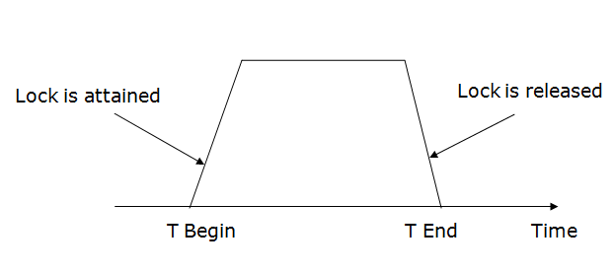

Slide 30
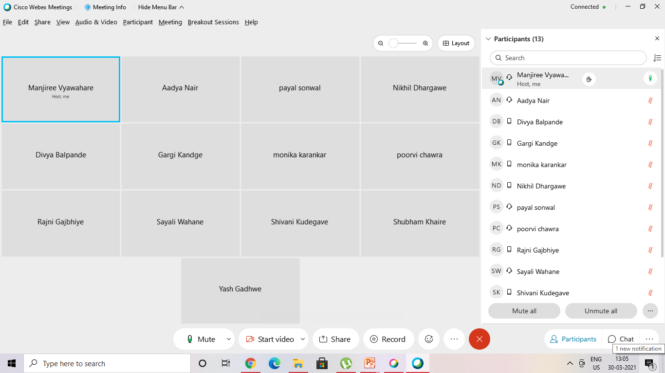
30 march 21

